Slide 1


Atliq Hardware Ad-hoc analysis
BY :- Kanhaiya Padol
Domain: Consumer Goods | Function: Executive Management

Slide 2
Objective
Atliq Hardware is a leading computer hardware manufacturer based in India, with a robust international presence.
The management has identified a gap in data-driven insights necessary for making prompt and informed decisions.
The company plans to expand its data analytics team by hiring junior data analysts to bolster their decision-making capabilities.
Tony Sharma, Director of Data Analytics, has devised a SQL challenge to evaluate potential candidates’ technical and soft skills.
The company aims to gain deeper insights through 10 ad hoc data requests as part of its enhanced analytics strategy.

Slide 3
Company Details
Atliq Hardware is a computer hardware and accessory manufacturer.
USB Flash devices
Internal
HDD
Graphic
Card
Category
External
Solid State
Drives
Networking
Division
Peripherals
Mother
board
"P & A" → Peripherals and Accessories
"N & S" → Network and Storage
"PC" → Personal Computer
Storage
Processors
N & S
USB
Flash
Drives
P & A
Segment
Batteries
Accessories
Business laptop
Desktop
Keyboard
PC
FISCAL YEAR
SEPTEMBER 2019 - AUGUST 2020
FY 2020
SEPTEMBER 2020 - AUGUST 2021
FY 2021
Notebook
Mouse
Personal Laptop
Personal
Laptop
Gaming
Laptop
Business
laptop

Slide 4
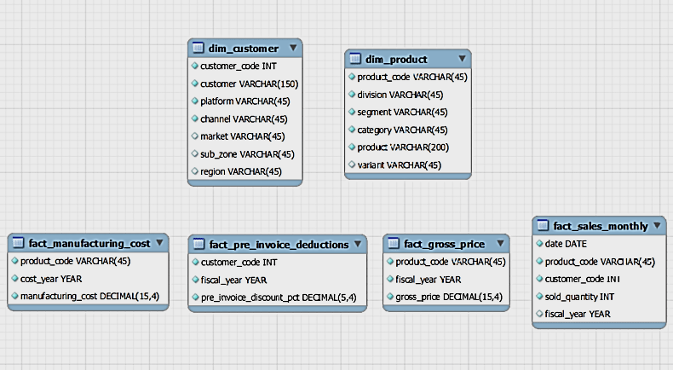
Overview of the data in the AtliQ Hardware database

Slide 5
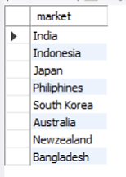
Provide the list of markets in which customer "Atliq Exclusive" operates its business in the APAC region
Insights:-
Atliq Exclusive operates its business in 8 countries in APAC region
Among this, India has the highest number of customers.

Slide 6
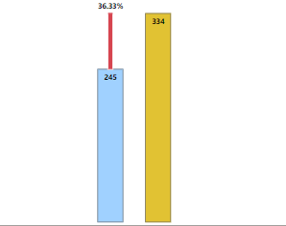

2. What is the percentage of unique products increase in 2021 vs. 2020?
The final output contains these fields --
unique_products_2020,
unique_products_2021,
percentage_chg )
36.33%
Percentage_change
Unique product 2020
Unique product 2021
Insights:-
FY 2020 - 245 Products
FY 2021 – 334 Products
Product count increase – 36.33% compared to FY 2020

Slide 7
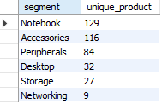
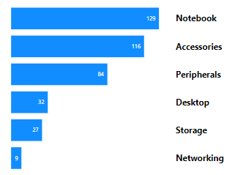
3. Provide a report with all the unique product counts for each segment and sort them in descending order of product counts. The final output contains 2 fields - segment,
product_count
Unique Product
Segment
Insights:-
The number of products we sell under the segment Notebook, Accessories & Peripherals are higher.
We need to increase our sales and production in the Desktop, Networking & Storage segments by providing some discounts

Slide 8
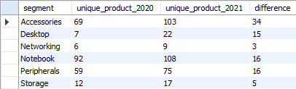
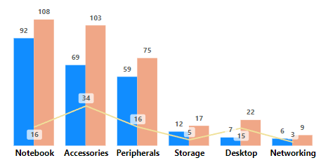
4.Which segment had the most increase in unique products in 2021 vs 2020?
(The final output contains these fields –
segment product_count_2020,
product_count_2021 difference
Insights:-
The Accessories segment had the most unique product increase in 2021 compared to 2020, with 34 new products
Networking and Storage segments) had the least increase(8) in products from 2020 to 2021.

Slide 9



5.Get the products that have the highest and lowest manufacturing costs.
The final output should contain these fields –
product code,
product,
manufacturing cost
$ 240.54
Highest manufacturing cost
AQ HOME Allin1 Gen 2
Personal desktop
$ 0.89
Lowest manufacturing cost
AQ Master wired x1 Ms
Mouse
The personal desktop “ AQ HOME Allin1 Gen 2 ” has the highest and the mouse “ AQ Master wired x1 Ms ” has the lowest manufacturing costs

Slide 10
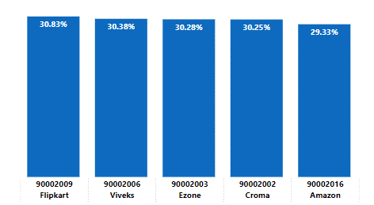
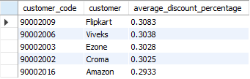
6. Generate a report which contains the top 5 customers who received an average high pre_invoice_discount_pct for the fiscal year 2021 and in the Indian market.
The final output contains these fields –
customer code,
customer,
Average,
discount percentage
Top 5 Indian customer with highest average discount percentage for year 2021
Customer & customer code
Insights:-
Largest average pre-invoice discount was given to Flipkart
Least average pre-invoice discount was given to Amazon

Slide 11
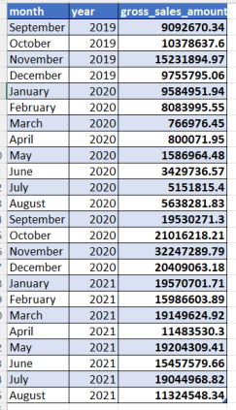
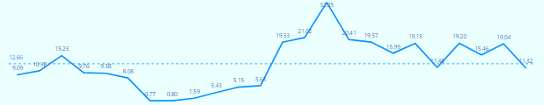
7.Get the complete report of the Gross sales amount for the customer “Atliq Exclusive” for each month . This analysis helps to get an idea of low and high-performing months and take strategic decisions.
The final report contains these columns:
Month, Year , Gross sales Amount
Average:-12.66 M
April
May
June
July
April
May
June
July
January
March
August
October
January
March
August
October
December
February
September
November
February
September
November
December
FY2020
FY2021
Values in Millions
INSIGHTS:
Being a physical store AtliQ-Exclusive’s gross sales had significantly dropped during the lockdown period between March and August in FY 2020 due to COVID 19. However AtliQ recovered quickly after August and in November, it experienced the highest sales in last two fiscal years.

Slide 12
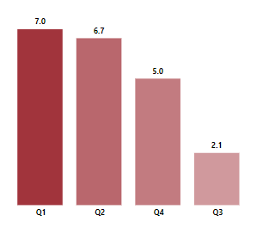

8.In which quarter of 2020, got the maximum total_sold_quantity?
The final output contains these fields sorted by the total_sold_quantity : Quarter, total_sold_quantity)
Quarter 1 of FY2020 saw the most units sold overall, while Quarter 3 had the
fewest.
The highest and lowest overall sold quantity is in December and March.
Quarter 1 accounts for approximately 34% of the total sold quantity for FY2020.
Total sold quantity in millions by quarters

Slide 13
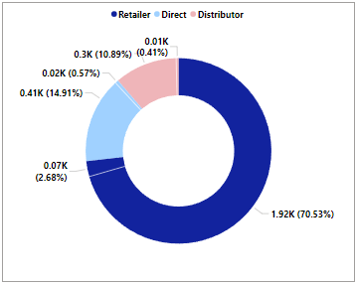

Which channel helped to bring more gross sales in the fiscal year 2021 and the percentage of contribution?
The final output contains these fields: channel, gross_sales_mln, percentage
Insights:
Channel:- "Retailer" helped bring maximum
sales to the company with 73.22% as the
contribution percentage.
Channel: "Distributor" makes the least
contribution at a percentage of 11.31%.

Slide 14
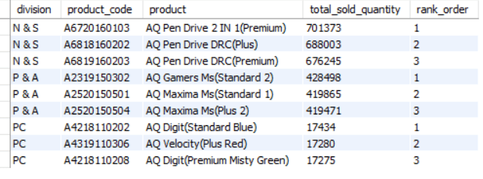
10. Get the Top 3 products in each division that have a high total_sold_quantity in the fiscal_year 2021?
The final output contains these fields: division, product_code
Insights:-
Every division has a product with different variants that appears twice in the top
three products by division list.

Slide 15
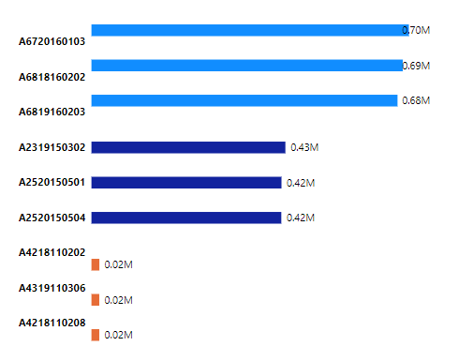
Top 3 products by division
AQ pen drive 2 in 1-Premium
AQ pen drive DRC-Plus
N & S
AQ pen drive DRC-Premium
AQ Gamers MS- Standard 2
AQ Maxima –standard 1
P & A
AQ Maxima ma -Plus 2
AQ Digit – standard Blue
PC
AQ Velocity – Plus red
AQ Digit – Premium misty green
Insights;-
Top 3 products by sold quantity in FY 2021 are different variant of Pen Drives in N & S division, different variant of Mouse in P & A division and different variant of Personal laptop in PC division.

Slide 16
Summary
Consolidating all :-
AtliQ’s gross sales increased in FY 2021.
AtliQ is changing and modifying its products which has become a profitable exercise.
Network & Storage division sold maximum quantity product in FY 2021. Although it brought only 12% of total gross sales amount. Also considering that this division had the least modification of product, I would like to suggest AtliQ to revise products sale price and introduce new products in Network & Storage division.
Thank You

